Slide 1
CSE205
Data Structures and Algorithms
Lecture #0
The kick start session

Slide 2
Course Details
Course Code:- CSE205
LTP:- 3 0 2 [3 lectures, 2 practical's /week]
Credits:- 4

Slide 3
Vision
To be a globally recognized school through excellence in teaching, learning and research for creating Computer Science professionals, leaders and entrepreneurs of future contributing to society and industry for sustainable growth.

Slide 4
Mission
To build computational skills through hands-on and practice-based learning with measurable outcomes.
To establish a strong connect with industry for in-demand technology driven curriculum.
To build the infrastructure for meaningful research around societal problems.
To nurture future leaders through research-infused education and lifelong learning.
To create smart and ethical professionals and entrepreneurs who are recognized globally

Slide 5

Revised Bloom’s Taxonomy

Slide 6
What will be the course outcome?
Understand the time and space complexity of programs and data-structures.
Illustrate the importance of linked list in context of real world problems
Differentiate the stack and queue data structures for problem solving
Use of recursion in iteration process and tree data structure
Analyze the effectiveness of AVL Tree and Heap Data Structures
Identify and integrating emerging data structures and algorithmic ensuring their ability to stay with technological advancements and maintain professional growth in a dynamic field

Slide 7
Program Outcomes achieved from the course
Apply the knowledge of mathematics, science, engineering fundamentals, and an engineering specialization to the solution of complex engineering problems.
Identify, formulate, review research literature, and analyses complex engineering problems reaching substantiated conclusions using first principles of mathematics, natural sciences and engineering sciences.
Design solutions for complex engineering problems and design system components or processes that meet the specified needs with appropriate consideration for the public health and safety, and the cultural, societal, and environmental considerations.

Slide 8
Program Outcomes achieved from the course
Create, select, and apply appropriate techniques, resources, and modern engineering and IT tools including prediction and modelling to complex engineering activities with an understanding of the limitations.
Recognize the need for, and have the preparation and ability to engage in independent and lifelong learning in the broadest context of technological change.

Slide 9
Program Educational Objectives achieved from the course
Apply acquired skills in software engineering, networking, security, databases, intelligent systems, cloud computing and operating systems to adapt and deploy innovative software solutions for diverse applications.
Apply diverse IT skills to design, develop, and evaluate innovative solutions for business environments, considering risks, and utilizing interdisciplinary knowledge for efficient real-time projects benefiting society.

Slide 10

Course Content
Introduction to data structures
Computation of complexity
Arrays, Sorting & Searching
Linked List
Stack and Queues
Recursions
Trees
Hashing
Graphs

Slide 11
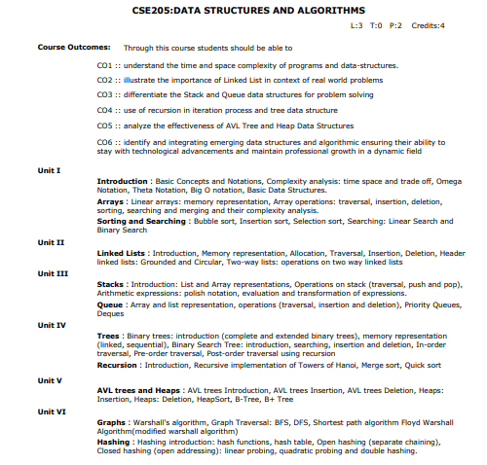
Syllabus

Slide 12
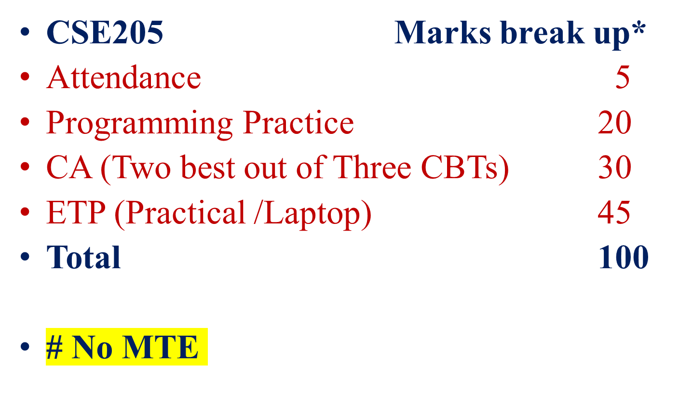
Course Assessment Model

Slide 13
Academic Tasks
Academic Task | Tentative Week
CA-1: Programming Practice (MCQs + Coding) (Mandatory) | Week1 – Week14
CA-2: Mix of MCQs(10 Marks) + Coding Problems(20 Marks) | Week 5
CA-3: Mix of MCQs(10 Marks) + Coding Problems(20 Marks) | Week 9
CA-4: Mix of MCQs(10 Marks) + Coding Problems(20 Marks) | Week 12

Slide 14
Practice Problems
In the Practice Problems marks are only for coding Problems.
MCQs are only for practice.
Unit wise Sequence locking

Slide 15
Marks Calculation for Programming Practice
In order to qualify for programming practice marks, the student must solve a minimum of 50% (50% Coding Problems + 50% MCQs) problems (eligibility condition)
No marks for MCQs.
Scoring Criteria:
The students will be given approx. 90 coding problems and 90 MCQs on the selected third party platform. The questions will be framed with equal distribution from the complete syllabus. In order to qualify for programming practice marks, the student should solve at least 50% of the coding problems and 50% of MCQ questions (eligibility condition).

Slide 16
Marks Calculation for Programming Practice
The maximum marks out of 20 marks for which the student would be eligible for Programming Practice would be based on the Percentage of scored marks in the questions solved by the student.
The final marks for Programming Practice would be calculated by prorating the eligible marks for which the student is eligible (as explained in the above point) with the percentage of marks student has scored in the proctored Coding Contests conducted as CBT’s (The final marks would be round up for the students).

Slide 17
Marks Calculation for Programming Practice
Example – If a student solves 63(Correct) questions out of 90 questions (i.e. 70% questions solved) then the student would be eligible for 70% of 20 marks which is 14 marks. And the student has scored 24 out of 30 in the CBTs i.e. 80% marks in CBTs, his Programming practice final marks would be 80% of 14 marks that he was eligible for which is 11.2 rounded up to 12 marks out of 20 for Programming Practice.

Slide 18
Daily Practice Problems
S. No | Unit | Question | Tentative Dates for Completion
1 | Unit-1 | At-least 15 Multiple Choice Questions and 15 Coding problems in each unit | 1st September 2024
2 | Unit-2 |  | 22nd September 2024
3 | Unit-3 |  | 29th September 2024
4 | Unit-4 |  | 30th October 2024
5 | Unit-5 |  | 6th November 2023
6 | Unit-6 |  | 17th November 2023
Note:- Most Important for the improvement of Performance in Course Assessments.

Slide 19
End Term Practical (45 Marks)
Online Assessment on third party Platform [50% ] [Mix of Coding Problem and MCQs]
Viva [50%]
# The marks scored in the online assessment will be prorated according to the viva marks, if the student scores less than 60% in the viva.

Slide 20
Why Star Course?
  Weightage in Gate/Govt. exams
  Industry demand
    Product Based
    Service Based
  Higher Studies
  Government Jobs

Slide 21
Execution Strategies
Topic: Activities | Details of the Activities Planned | Is this Activity a part of Evaluation (Yes/No): Which CA/MTE/ETE | Tentative week of conduct of activity | Responsibility: Who will ensure the conduct of the activity (specify the plan for the same) | Expected Outcome | References | Quantification
First Continuous Assessment | The continuous assessment will be planned as a coding test consisting of 2 coding questions and 10 MCQs on an online judge. | Yes | 5 | The concerned subject teacher will ensure the smooth conduct of the activity. | Evaluation and reiteration of the taught concepts. | NA
Second Continuous Assessment | The continuous assessment will be planned as a coding test consisting of 2 coding questions and 10 MCQs on an online judge. | Yes | 10 | The concerned subject teacher will ensure the smooth conduct of the activity. | Evaluation and reiteration of the taught concepts. | NA

Slide 22
Execution Strategies
Details of Course Enrichment Activities
Third Continuous Assessment | The continuous assessment will be planned as a coding test consisting of 2 coding questions and 10 MCQs on an online judge. | Yes | 12 | The concerned subject teacher will ensure the smooth conduct of the activity. | Evaluation and reiteration of the taught concepts. | NA
End Term Practical | Assessment will be conducted on the third-party platform consists of coding problems and MCQs, Followed by the viva by the neutral examiner | Yes | After 14th week | Will be planned by the examination division | Evaluation and test the overall learning | NA
Software Mapping | Dev C++/GCC/Online Compiler will be used for the live coding demonstration during the classes | Yes | 1st class onwards | The concerned subject teacher will use the platform from 1st lecture onwards in their classes for reference | Hands on the software | NA

Slide 23
Execution Strategies
Use of third party platform for evaluation | All the assessments including ETP and Programming practice will be done on third party platform | Yes | Student will solve the coding problems and MCQs on the third party platform in all the assessments | The concerned subject teacher will ensure the smooth conduct of the activity. | Use of the third-party platform in assessment to improve the skills | NA
Details for Pedagogical Initiatives for the above-mentioned course
Lecture Number | Pedagogical Initiative | Expected Outcomes | References | Quantification
Lecture Number 1 onwards | Live demonstration of code and third-party platform use | The students will be well versed with coding concepts and will have the necessary knowledge how to write code. | Material available on the online platform

Slide 24
Execution Strategies
Evaluation strategy for all Components of the courses
Type of Assessment (Add rows in case some other assessments are applicable) | Type of Assessment e.g. Test/Term Paper/project etc. | Details of academic task | Parameters/Rubric of Evaluation | External/Internal | Details of External Evaluations | References | Quantification
Coding Contest | Test | The continuous assessment will be planned as a coding test consisting of 2 coding questions and 10 MCQs on an online judge. | The code will be auto evaluated by an online judge | External online judge | The code written by the student will be evaluated on the online judge. | NA
Programming Practice | Test | The student will be asked to attempt approx. 90 problems with 15 problems per unit. Problems will open unit wise. | The problems will be auto evaluated by an online judge | External online judge | The code written by the student will be evaluated on the online judge. | NA

Slide 25
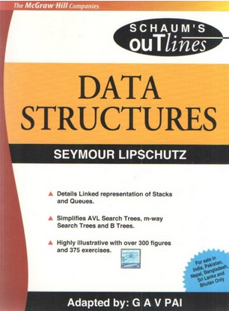
Text/Reference books
Books to Follow
Data Structures (Schaums' Outlines Series)
Author - Seymour Lipschutz
Data Structures And Algorithms
By Alfred V. Aho, Jeffrey D. Ullman
And John E. Hopcroft, Pearson

Slide 26
Cohort
Software Development
  Product based
  Service based

Slide 27
MOOCs
Not Applicable

Slide 28
OER
Unit mapped | Broad topic | OER Type | Title of OER | *%age unit mapped with OER (approx) | Source URL
Unit 1 | Arrays, Sorting and Searching | Reading material (online tutorial), Practice Questions | Learn Data Structures and Algorithms |DSA Tutorial | 70% | https://www.geeksforgeeks.org/array-data-structure/?ref=lbp
Unit 2 | Linked Lists | Reading material (online tutorial), Practice Questions | Learn Data Structures and Algorithms |DSA Tutorial | 90% | https://www.geeksforgeeks.org/data-structures/linked-list/?ref=lbp
Unit 3 | Stacks, Queue | Reading material (online tutorial), Practice Questions | Learn Data Structures and Algorithms |DSA Tutorial | 70% | https://www.geeksforgeeks.org/stack-data-structure/?ref=lbp

Slide 29
OER
Unit 4 | Trees, Recursion | Reading material (online tutorial), Practice Questions | Learn Data Structures and Algorithms |DSA Tutorial | 70% | https://www.geeksforgeeks.org/introduction-to-tree-data-structure-and-algorithm-tutorials/?ref=lbp
Unit 5 | AVL trees and Heaps | Reading material (online tutorial), Practice Questions | Learn Data Structures and Algorithms |DSA Tutorial | 80% | https://www.geeksforgeeks.org/introduction-to-avl-tree/?ref=lbp
Unit 6 | Graphs, Hashing | Reading material (online tutorial), Practice Questions | Learn Data Structures and Algorithms |DSA Tutorial | 80% | https://www.geeksforgeeks.org/graph-data-structure-and-algorithms/?ref=lbp

Slide 30
SkillSet
Programming Skills
Logic buiding
Code analysis

Slide 31
Platform Used
Live Demonstration of IamNeo Third Party Platform
URL: https://lpucolab438.examly.io/login
LoginId: RegistrationNo@neocolab.ai
Password: RegistrationNo

Slide 32

Zero Lecture - Feedback

Slide 33

Next Class: Basic Data Structures

